Slide 1
PMBB
Ontology Informed Software Design

Slide 2
Introduction
Who we are, where we’ve been, and where we’d like to go.

Slide 3
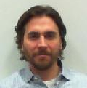
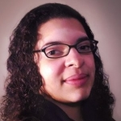
We Are Programmers
Heather and David are computer programmers with education in computer science, math, and robotics.
David has 12+ years experience programming in the biomedical domain.
Heather is an experienced programmer with 3+ years of experience in the biomedical domain.
No Background In Ontologies

Slide 4
The Ontology Arc
5-7 years
Hearing the word “ontology” for the first time
Trying to understand ontology concepts
Learning about ontology related technologies
Looking up “ontology” in the dictionary
Seeing how ontologies are useful
Incorporating ontologies into technology

Slide 5

The (Sad) Truth
Most programmer have never heard the word ontology
It was surprisingly difficult for our software engineers to grasp ontology theory
This feels like a potentially nice undergraduate elective

Slide 6

The (Eventual) Realization
Ontologies are more than leveled up lookup lists, which seems to be the typical first impression
Ontologies can help software engineers model information and design software!

Slide 7
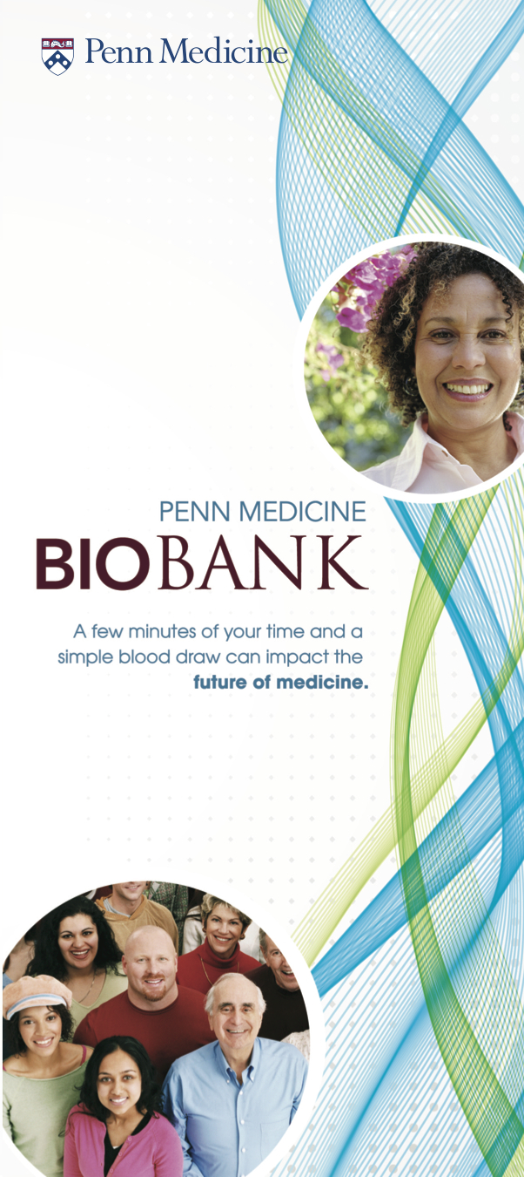
Penn Medicine Biobank
Heather and David became the Penn Medicine Biobank informatics team in 2013
Even though we still did not understand ontologies, based on our experience of them we felt that we should incorporate an ontology into our efforts
Our goal was a web based system that supported biobanking and provided an ontologized query interface

Slide 8
The Biobanking Problem
Protocols, collection kits, specimen collection, processing, storage, and retrieval.

Slide 9
Biobanking Lifecycle
Specimen
Collection
Processing
Storage
Protocol specification
Specimen retrieval
Information is produced at each stage and needs to be tracked at a very granular level.

Slide 10
Biobanking Information
Protocol specification
Time points
Collection kits
Specimen containers
Case report forms
Human subject phenotype
Demographics
Disease history
Family history
Medications
Specimen collection
Time
Location
Specimen
Type: blood, tissue, ...
Measurements: volume, mass, …
Type specific attributes
Blood hemolyzation
Tissue disease type
Procurement site
Processes
Aliquot
Spin: duration, cell separator, …
Tissue fixation: fixative, …
Freeze
Storage
Location

Slide 11
The PMBB Solution
Web based system to support specimen collection, processing, and storage with a ontology friendly search system.

Slide 12
Application Components
Database Application
Data Transformer
SparQL Endpoint

Slide 13
Programmers Are Very Lazy
Database Application
Data Transformer
SparQL Endpoint
The data transformer seemed like a lot of work
Maybe if we design our application well, we will not need a heavy data transformation step
Why not start with an ontology friendly database design and save some overall effort

Slide 14
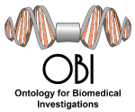
The Plan
Follow two OBI tenets during our software design and implementation
Stay reality based
Model real world events as processes

Slide 15
PMBB Applications
The Squash family of biobanking applications.

Slide 16
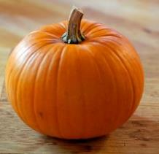
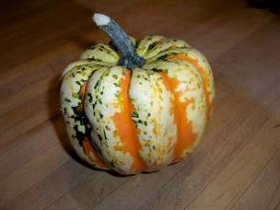
Squash Family of Applications
Pumpkin
Specimen Collection and Processing
Spaghetti/Carnival
Data Unification and Search
Live in June 2013
>90,000 specimens, >8,000 collection events
In progress
Prototyped with D2RQ and small relational data sets.
Notes:
----- Meeting Notes (10/3/14 15:57) -----
Pumpkin
protocol definition
kit generation
specimen collection, processing, storage
Spaghetti
data unification
Carnival
search

Slide 17

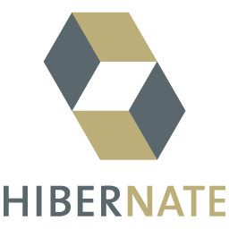



Pumpkin Technologies
Grails - An Open Source MVC web application framework for the JVM
Java
Many mature existing java libraries
Groovy – Dynamic language for the JVM
Modern language features, like closures
Hibernate – Object-relational mapping library for Java
Natural modeling of complex objects
MySQL – Open source relational database management system
Notes:
…our root technology has been grails, an open source web app framework for the jvm. Grails utilizes other technologies….
…the speed at which we were able to iterate on prototypes in the early design phases was extremely important…

Slide 18
Grails Models– GORM and Domain Classes
GORM – Grails Object Relational Mapping is Grails’ ORM (Object Relational Mapping) implementation. Uses Hibernate 3 under the hood.
Implemented with domain classes. Domain classes contain simple and complex objects and support one-to-many, many-to-one, and many-to-many relationships. Class inheritance is supported. Validation rules and constraints can be added to the domain class.
GORM creates and maintains the appropriate database structure to reflect the domain classes.
class Book {
String title
Author author
static constraints = {
title blank: false, size: 5..150
author nullable: true
}
}
Notes:
...Grails follows the MVC design pattern. There is not enough time to give an overview of the entire grails stack, but will dive into grails domain models in some detail b/c that was instrumental in allowing our reality based approach…
…technical explanation here…

Slide 19
OBO and Domain Models
Classes in OBO can be represented by Grails domain classes
Class relationships can be represented via inheritance and validation constraints
Data produced by such domain models
honor class relationships in the ontology
are easily translatable to and consumable by ontology aware tools
Designing domain models based on realism makes them easy to extend as new requirements are added
Notes:
----- Meeting Notes (10/3/14 15:51) -----
the domain instances produced will honor the class relationships in the ontology

Slide 20
OBO Inspired Domain Models – Specimen Processes
abstract class SpecimenProcess {
static constraints = {...}
static hasMany = [
inputSpecimens:Specimen,
inputEmptySpecimenContainers:SpecimenContainer,
outputSpecimens:Specimen,
outputSpecimenContainers:SpecimenContainer
]
/* the participating user */
User user
/* The input specimen(s) for this process */
SortedSet inputSpecimens
/* The input empty specimen containers for this process */
SortedSet inputEmptySpecimenContainers
/* Specimens created by this process */
SortedSet outputSpecimens
/* Specimens containers created by this process */
SortedSet outputSpecimenContainers
/* Time the process started */
Date startTime
/* Time the process finished */
Date endTime
}

Slide 21
OBO Inspired Domain Models – Concrete Specimen Processes
abstract class SpecimenProcess {
static constraints = {...}
static hasMany = [
inputSpecimens:Specimen,
inputEmptySpecimenContainers:SpecimenContainer,
outputSpecimens:Specimen,
outputSpecimenContainers:SpecimenContainer
]
/* the participating user */
User user
/* The input specimen(s) for this process */
SortedSet inputSpecimens
/* The input empty specimen containers for this process */
SortedSet inputEmptySpecimenContainers
/* Specimens created by this process */
SortedSet outputSpecimens
/* Specimens containers created by this process */
SortedSet outputSpecimenContainers
/* Time the process started */
Date startTime
/* Time the process finished */
Date endTime
}
class SpinProcess extends SpecimenProcess {
static constraints = {...}
static hasMany = [specimensToCreate:SpecimenToCreate]
/* the duration of this spin */
Double duration
/* optional cell separator */
CellSeparator cellSeparator
}
class DiluteProcess extends SpecimenProcess {
static constraints = {...}
/* Liquid Dilutent*/
Diluent diluent
}

Slide 22
Specimen Processes in Action – Graphical Data
Instances produced by such models can be naturally represented by directed graphs
Data duplication is minimized
The graph can queried in rich ways

Slide 23
Spaghetti/Carnival - Prototyping
Annotated several small distinct data sets (specimen data, basic demographic data) using OBI
Created a unified SPARQL endpoint using D2RQ, a program that presents relational data as RDF endpoint by converting SPARQL queries to SQL
Created a pseudo-natural language -> SPARQL parser that converts a natural language query to a SPARQL query
Created a basic web endpoint to accept a NL query and display results

Slide 24
Spaghetti/Carnival – Future Plans
Use data produced by Squash applications
Use a graph database to store data
Generate the natural language parser semi-automatically from .owl files
Experiment with query interfaces and data visualization techniques

Slide 25
Closing Thoughts
What we think we learned, our hopes, and our dreams.

Slide 26
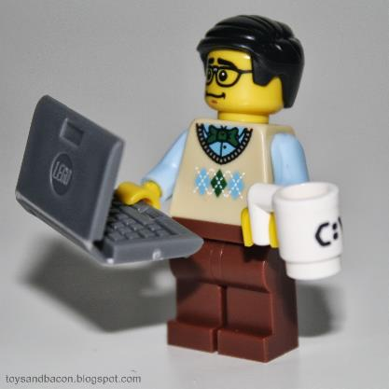
Programmers and Data
Programmers can handle simple data
Programmers are learning how to handle big data
Programmers are not that great at handling complex highly connected semantically rich data

Slide 27
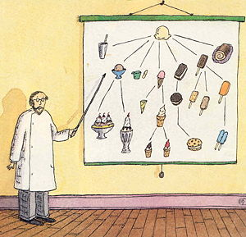
Ontologists and Data
The average ontologist has forgotten more about complex highly connected semantically rich data than the average programmer would even imagine existed in the first place

Slide 28
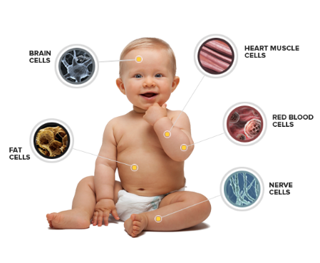
Our Worlds Are Colliding In The Universe of Biomedical Investigations
Programmers are ill-equipped to handle biomedical information
Ontologists are better at it
We are excited at the possibility of increased interaction between programmers and ontologists resulting in new programming methods and technologies

Slide 29
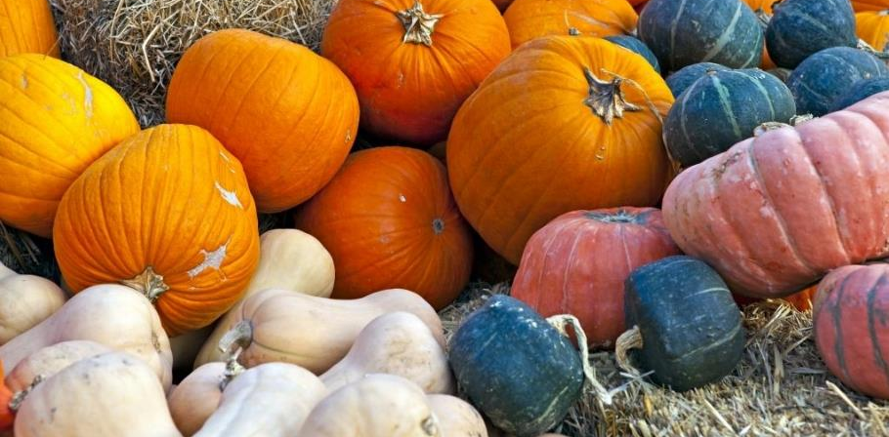
The saga continues…
The Penn Medicine Biobank is doing well so far. We will continue with our quest to write ontology informed biobanking software in the hopes that one day our work can benefit a wider audience.

